Slide 1


A Sustainable
Solutions
Company…
Where innovation and sustainability meet
Where innovation and sustainability meet.

Slide 2
Where innovation and sustainability meet
Biodose are constantly seeking out the latest disruptive technologies to deliver superior, sustainable cleaning solutions to our customers throughout the world
These technologies incorporate efficiencies in packaging, shipping, storage and dispensing equipment

Slide 3



BRANDS

Slide 4
URINAL DRAIN TREATMENT
For commercial applications

Slide 5
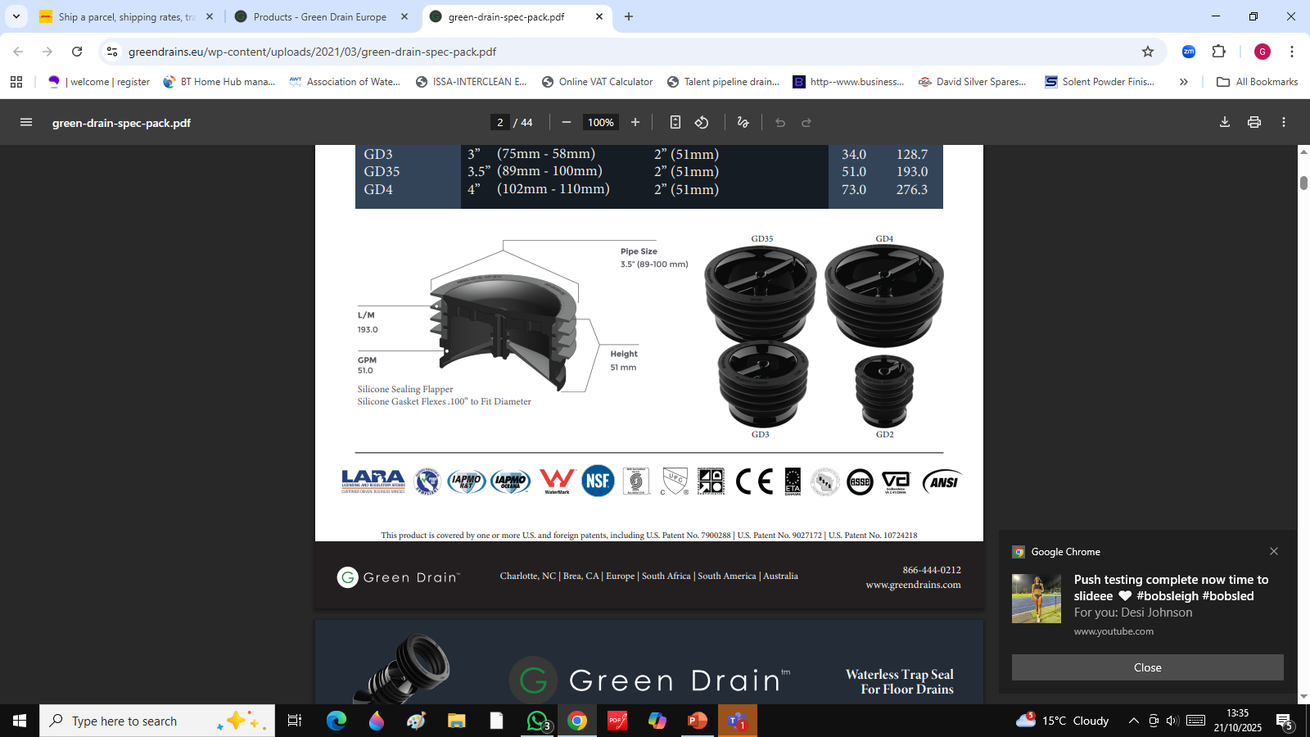
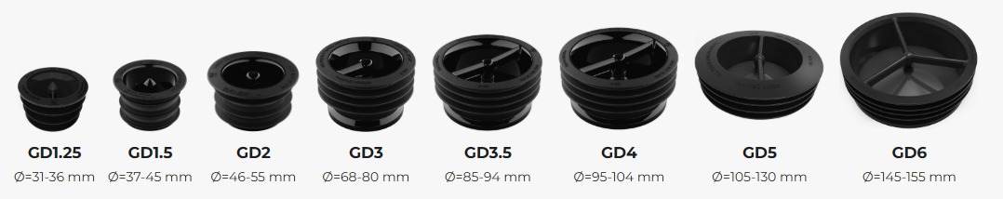
Waterless Trap Seal for floor drains
Prevents odours from coming up your drain
Stops pest from entering your premises
Prevents the spread of viruses and bacteria
Protects from sewer gases
Allows a high flow of water down the drain
Available in various sizes

Slide 6
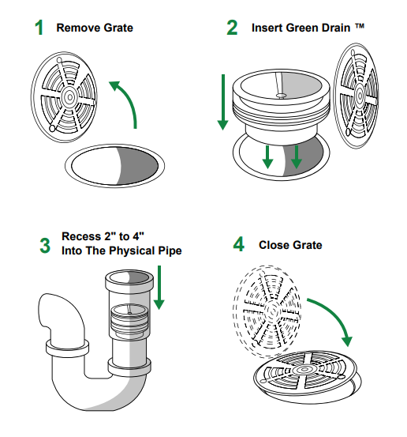
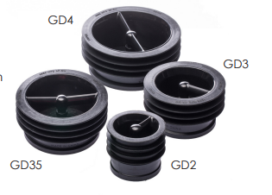
Waterless Trap Seal for floor drains
Easy to install, simply measure the inner diameter of your drain and match to the appropriate GD seal
Fit as per instructions

Slide 7
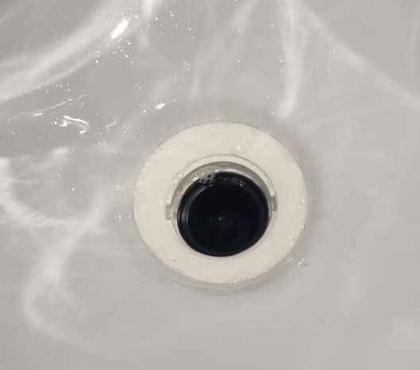
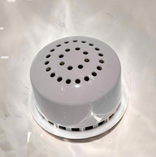
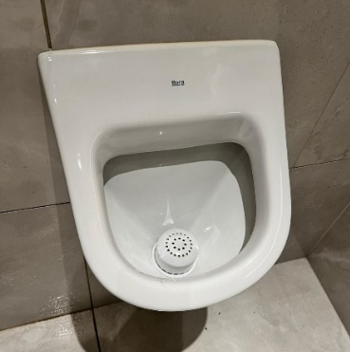
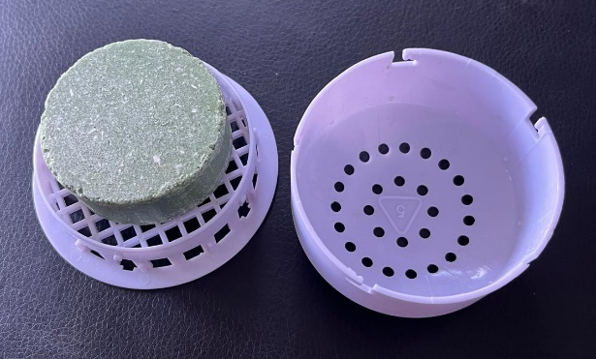
Waterless Trap Seal with Urinal Cartridge
Small urinal drain illustrated GD15 (37MM-45MM)
Replaceable puck
Trap Seal
Cartridge
Twist to open the cartridge and
replenish urinal puck

Slide 8
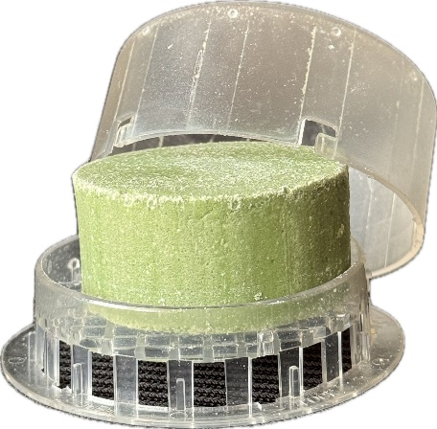
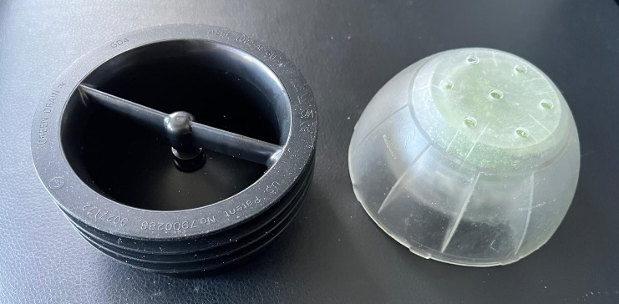
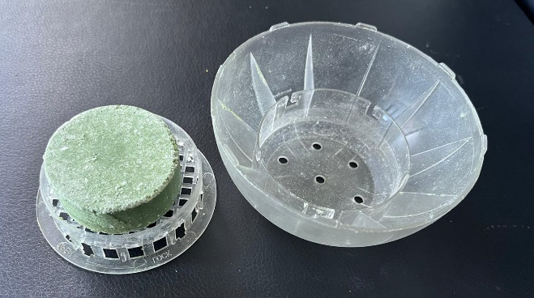
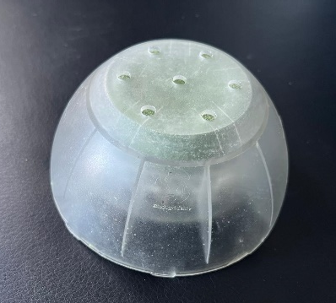
Waterless Trap Seal with Urinal Cartridge
Large urinal drain illustrated GD4 (95MM-104MM)
Replaceable puck
Large enough to replace a waterless cartridge system
Twist to open the cartridge and
replenish urinal puck
Trap Seal
Cartridge

Slide 9
A Sustainable
Solutions
Company…
Where innovation and sustainability meet
Where innovation and sustainability meet.

